Slide 1
Understanding motor units and their role in electromyographic signals
Olivier Bergeron

Slide 2
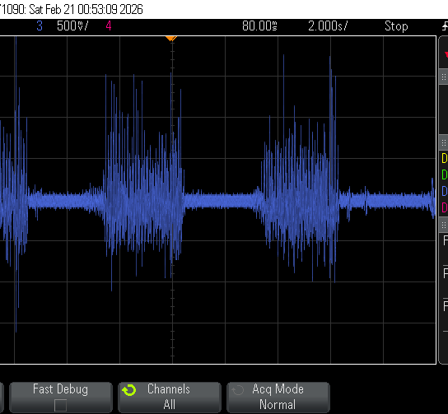
Introduction
Electromyography (EMG)
Recording of the electrical activity of muscle tissue
Applications
Nerve damage
Dystrophy
Optimizing performance
Prosthetic
Notes:
Definition of electromyography
Applications:
Study of nerve damage after accident
Muscle dystrophy
Optimizing performance (ex: in sports)
Prosthetic (ex: hand prosthetic)

Slide 3
Introduction
Notes:
Direct the last slide of explaining EMG signal to the subject of the presentation:
- What happens inside the body when we want to contract muscles?

Slide 4
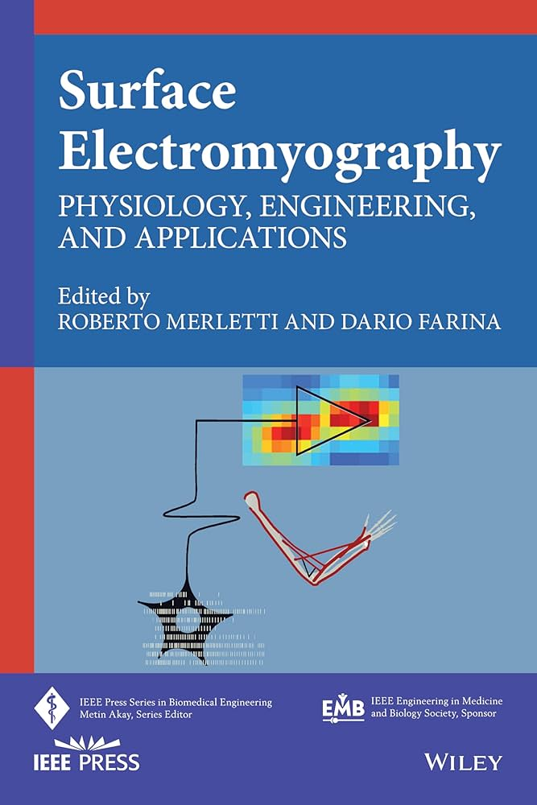
Introduction
D. Farina et R. Merletti, Éd., Surface electromyography: physiology, engineering, and applications. dans IEEE Press Series on Biomedical Engineering. Piscataway, NJ: IEEE Press, 2016.
Notes:
Explain that the theory comes from this document

Slide 5
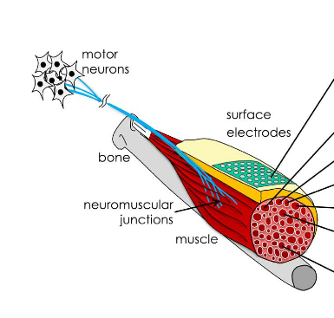
Motor Unit - Theory
D. Farina et A. Holobar, « Characterization of Human Motor Units From Surface EMG Decomposition », Proc. IEEE, vol. 104, nº 2, p. 353‑373, févr. 2016
Notes:
Motor unit anatomy:
Muscles: part that actionnates under electrical stimuli
Neuromuscular junctions (or innervation zone): section on the muscle where nerves are connected
Nerves: Wires that transfers electrical signal from the neurons
Motor neurons: generates the spikes to activate the muscles. Still managed by the brain, but out of scope for the presentation

Slide 6
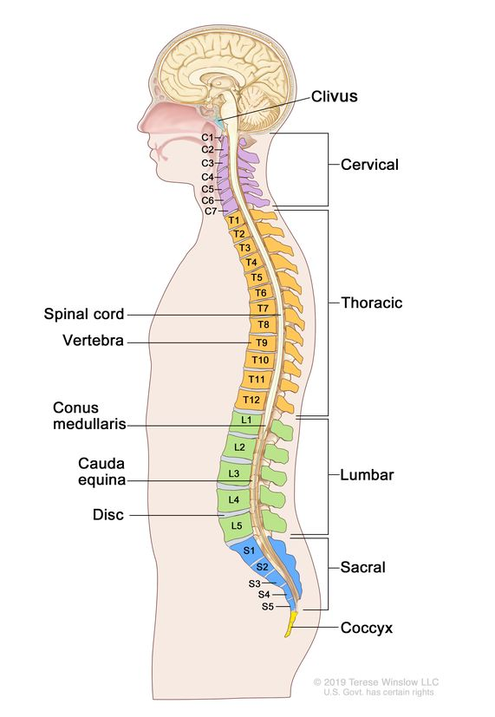
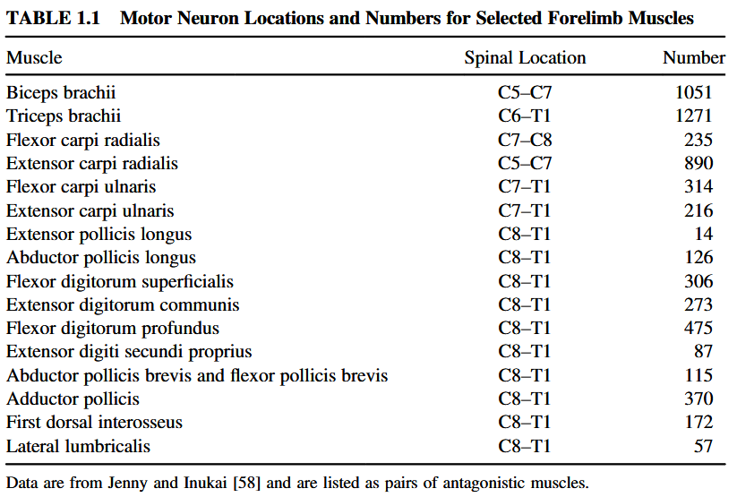
Motor Unit - Theory
“https://www.cancer.gov/publications/dictionaries/cancer-terms/def/spine,” www.cancer.gov, Feb. 02, 2011. https://www.cancer.gov/publications/dictionaries/cancer-terms/def/spine
Notes:
Table for number and location of motor neurons for forelimb muscles
Extensor digitorum communis: Responsible for extending the 4 fingers (not the thumb)
Show the location on my back of where this is
For the thumb: Extensor pollicis.

Slide 7
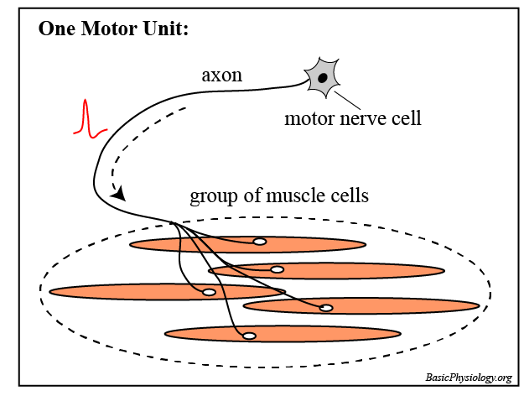
Motor Unit - Theory
Every motor unit is different
Recruitment threshold
Force production
Contraction speed
Fatigue resistance
EMG shape
Basicphysiology.org, 2026. https://www.basicphysiology.org/wp-content/uploads/2023/04/Motor-Unit-sketch.png (accessed Apr. 13, 2026).

Slide 8
Motor Unit - Theory
Recruitment
Rate Coding
Notes:
Recruitment and Rate coding
Recruitment: More and more motor units are used for applying force. Depends of the recruitment threshold
Rate coding: How much force is required from a single motor unit
Reality is a mix of the two.

Slide 9
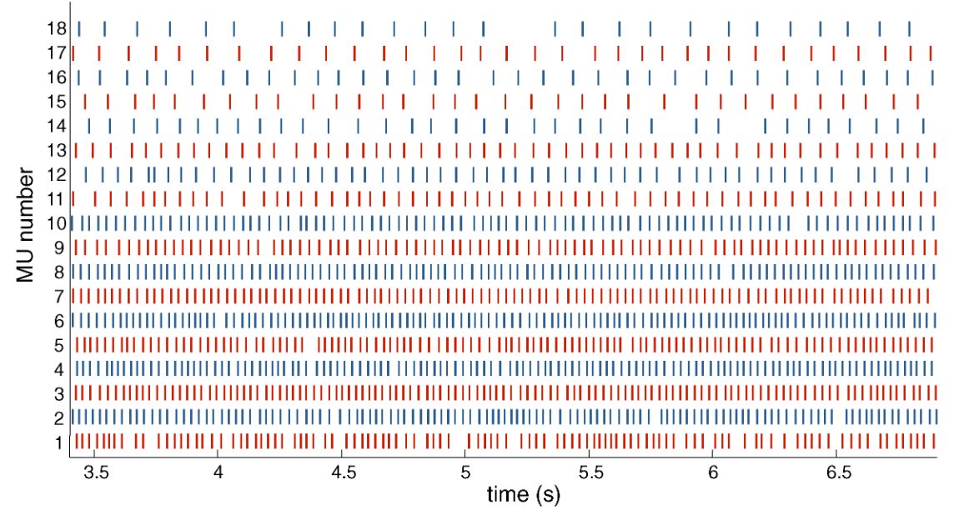
Motor Unit - Theory
Notes:
Example of a graph representing motor unit spike trains (or discharge train)

Slide 10
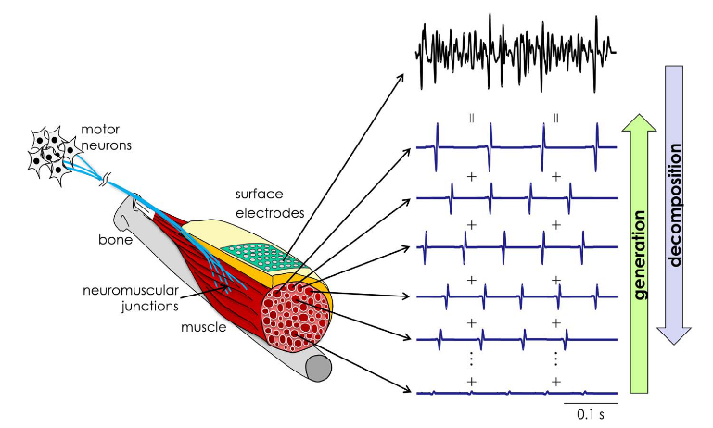
Motor Unit - Theory
Notes:
Relation between motor unit discharges and EMG signals.
The EMG signal is the sum of every activation of motor units (after different effect applied to the signal)

Slide 11
Motor Unit - Theory
Multiple layers
Skin
Fat
Sweat
Blood
Other muscles
Impacts
Amplitude loss
Spatial blurring
Notes:
Different elements of the body modify the signal.
Skin
Fat
Sweat
Blood
Other muscles
Impacts:
Loss of amplitude the more a signal has to travel. Has a low pass type of response
Spatial blurring: Signals mixes together and is hard to decompose. Also a presence of crosstalk

Slide 12
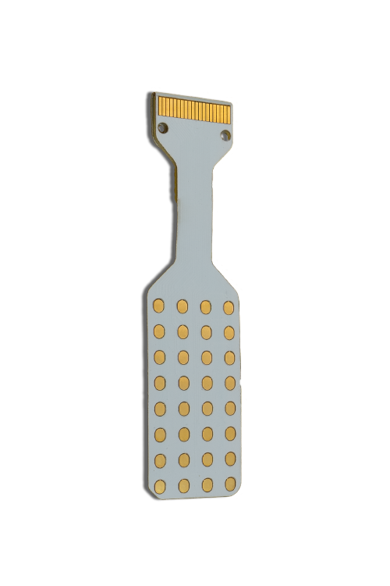
Motor Units - Extraction
Parameters
Type
Material
Quantity
Size
Inter-Electrode Distance
Other
Algorithms
Contraction strength
“HD05MM0804,” OT Bioelettronica, Dec. 18, 2025. https://otbioelettronica.it/en/product/hd05mm0804/ (accessed Apr. 13, 2026).
Notes:
A electrode is used to extract EMG signals. More often than not, an array of electrode is used. Different parameters of the electrode:
Electrode type: i.e. where the signal is measured
Its material
The quantity
Its size
Its distance from adjacent electrodes
Other factors to take into account for motor unit decomposition:
The algorithm used to extract
The contraction strength

Slide 13
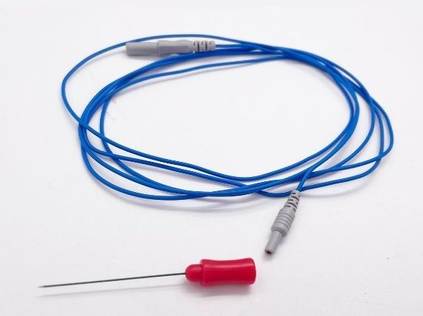
Motor Units - Extraction
Type
Intramuscular
Surface
Difference
Comfort
Signal quality
“Monopolar EMG Needle Electrodes - BESDATA,” BESDATA, Jun. 21, 2022. https://besdatatech.com/monopolar-emg-needle-electrodes/
‌
Notes:
The electrode type: where the measurement is made
Surface: An electrode is set on the skin to measure the signal at the surface. It is the more comfortable option at the detriment of signal quality
Intramuscular: an electrode is inserted into the body to be close to the muscle. The SNR is the best since less modification of the signal from travelling to the surface of the skin. But, obviously, not the more comfortable option.
Says that for the following, only parameters for a surface electrode will be discussed since it’s what the article is about

Slide 14
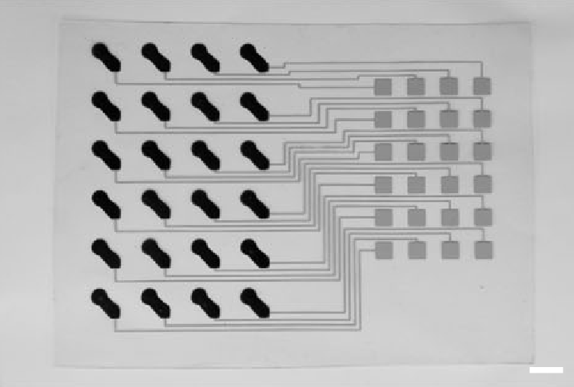
Motor Units - Extraction
Material
Metal
Polymer
Impact
Signal quality
Reusability
Comfort
S. Yang et al., « Stretchable surface electromyography electrode array patch for tendon location and muscle injury prevention », Nat Commun, vol. 14, no 1, p. 6494, oct. 2023
Notes:
Material of the electrode. Different material give different responses. Main material used is metal (Silver, Gold, Platinum). Polymers are also possible. Example of the right is PEDOT:PSS PEDOT:PSS : Poly(3,4-ethylenedioxythiophene) polystyrene sulfonate

Slide 15
Motor Units - Extraction
Electrode
Average measurement over its surface
Low-pass filtering
Large electrode diameter
More stable
Small electrode diameter
More precise
Notes:
Diameter
An electrode averages the value over its surface area. It is the same as a low-pass filter.
A larger electrode means a bigger average, so a higher low pass effect. But it also means that the signal is more stable (i.e. less noisy)
A smaller electrode means a more precise measurement for a local point on the skin. But, more impacted by noise by reducing the averaging.

Slide 16
Motor Units - Extraction
Inter-electrode distance (IED)
Measurable spatial variations depends on the distance
Low-pass filtering
Large IED
More global
Small IED
More precise
Notes:
IED
Signals travels at approx 3 to 5 m/s
Spatial variation (i.e. in respect to time) can be detected if the électrodes are close enough to one another.
Same-ish theory as Nyquist frequency (not the exact same relation, but same in concept):
- The higher the frequency of electrode in space (i.e. the closer they are), the more spatial information can be collected

Slide 17
Motor Units - Extraction
Quantity of electrode
Equivalent of a map
The more, the better
Diminishing returns
Notes:
Quantité
Add image that shows difference from low to high quality

Slide 18
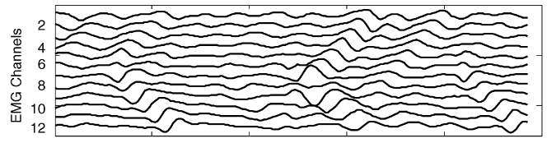
Motor Units - Extraction
Notes:
Use this slide as an example to how signal travels in space (IED slide and quantity slide)
Also, quick mention to the algo. We can patterns in the waves. So, we can extract those patterns and classify them as a motor unit.

Slide 19
Motor Units - Extraction
Important factor: Relative maximum voluntary contraction (%MVC)
Too high %MVC: Hard to decompose motor units
Notes:
Relative maximum voluntary contraction: Force exerted by muscles relative to their maximum.
When small enough, it is easier to decompose the motor units. But when too high, spatial blurry becomes too much and smaller motor units can’t be decomposed.
2 examples to understand:
1- Try to use you hand with dexterity with arm fully contracted
2- Audio with multiple speakers. The louder the speakers at the same time, the harder it is to know which one output what sound

Slide 20
Article Analysis
A. H. Caillet et al., « Larger and Denser: An Optimal Design for Surface Grids of EMG Electrodes to Identify Greater and More Representative Samples of Motor Units », eNeuro, vol. 10, nº 9, p. ENEURO.0064-23.2023, sept. 2023
Notes:
Article Analysis:
Arnault H. Caillet
Directed by Dr. Dario Farina
Article published in 2023

Slide 21
Article Analysis
Hypothesis
Higher count and higher density results will increase the count of detectable motor units
Two parts for the experiment
Simulations
Real measurements
Notes:
Hypothesis: Denser and larger electrode grid will increase the number of motor units extracted.
The experiment took 2 parts:
1- Simulation for theorical data
2- Real measurements with variable parameters

Slide 22
Article Analysis
Simulation
200 motor units simulated
Variable grid size and IED
Goal: estimate maximum detectable motor units
Notes:
Simulation part:
200 motor units were simulated to see how many motor units can be extracted when:
The IED changes
The grid changes size (i.e. with a smaller count of electrodes)

Slide 23
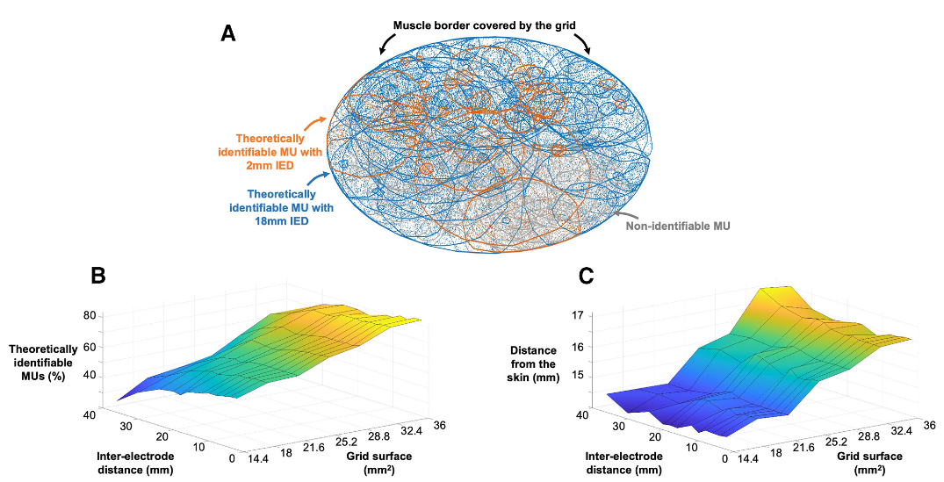
Article Analysis
Notes:
Simulation results:
Smaller IED and bigger grid seems to be able to extract smaller motor units and extract motor units that are deeper in the limb
Theorical value for used grid: (77.8 ± 5.5) %

Slide 24
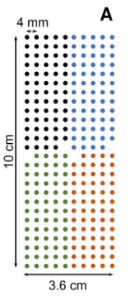
Article Analysis
Real measurements
Six participants
Muscle tested: tibialis anterior
Two contractions: 30 %MVC & 50 %MVC
Two electrode grids
Both grids: 256 electrodes and 1 mm diameter
4 mm IED vs 2 mm IED
Notes:
Real measurement setup
6 participants (22 to 30 years old) for the first grid: 256 electrodes (13 x 5 – 1 corner), 1 mm diameter, 4 mm IED
Only one participant for the second grid (ultra dense one): 256 electrodes (13 x 5 – 1 corner), 1 mm diameter, 2 mm IED

Slide 25
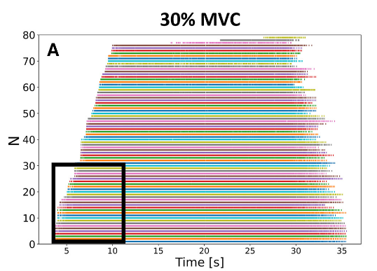
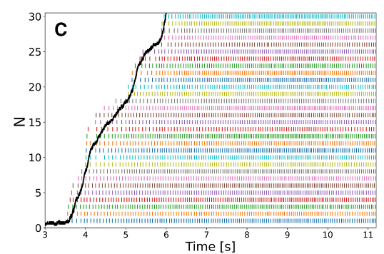
Article Analysis
Notes:
Results: 79 motor units extracted at 30 %MVC

Slide 26
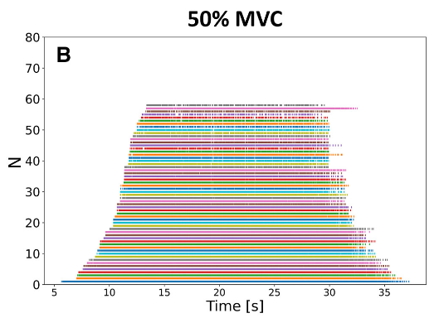
Article Analysis
Notes:
58 motor units at 50 %MVC

Slide 27
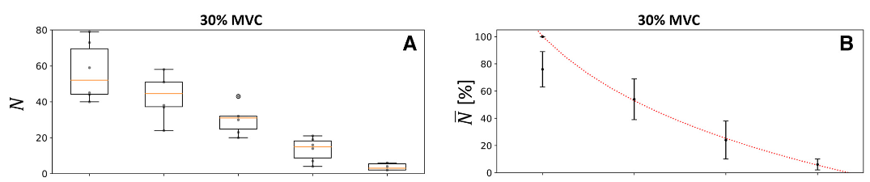
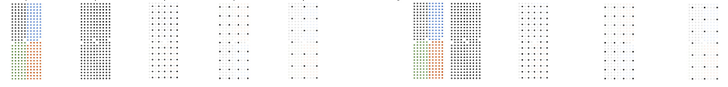
Article Analysis
Notes:
30 %MVC
Results for changing density, but keeping the same surface. I.e., changing the IED and less electrodes

Slide 28
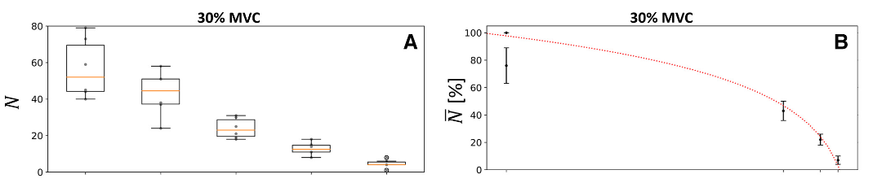
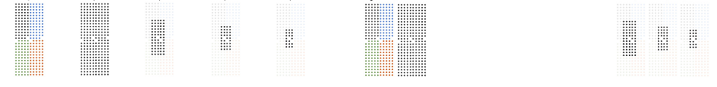
Article Analysis
Notes:
30 %MVC
Results for keeping density, but smaller grids (i.e. less electrodes)

Slide 29
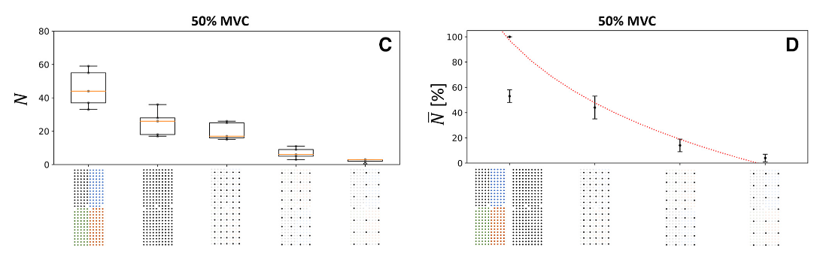
Article Analysis
Notes:
Same here for 50% MVC for density

Slide 30
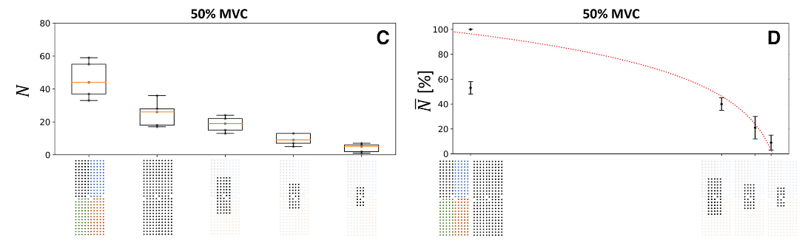
Article Analysis
Notes:
Same here for 50% MVC for same density but less coverage

Slide 31
Article Analysis
Very good analysis of impact of different parameters
Two things missing
Coverage on the whole leg
Test on different body part (ex: arm)
Notes:
My analysis of this article:
Very complete for the test of variable parameters
But, in my opinion, 2 parameters are missing:
1- The electrode grids do not make a whole revolution around the limb. Signals can be detected on the other side. That might add precision to the extraction
2- Not all limbs have the same motor units. For example, leg muscles have more motor units related to low force and fatigue resistance for posture purposes, but the arm has more motor units related to dexterity movements (for the hand)

Slide 32
Conclusion
Potential application to motor unit analysis:
Prothesis
Rehabilitation
Neuromuscular diseases diagnostic
Notes:
Conclusion: Show applications where motor unit decomposition is/can be useful.
Prothesis: Motor units could be associated to certain movements. So, the extraction of the spike discharges could help make fine movement instead of “endpoint” movements
Rehabilitation: After injuries, monitoring of the motor units could help see if there any nerve damage of neuron damage
My favorite of the bunch: motor units can be used to diagnostic neuromuscular diseases earlier, since those type of diseases are influenced by anormal spike discharges.
Use my case as an example with essential tremors, where I’m always shaking when contracting muscles. With my master’s thesis, I am curious to compare my data with other without tremors

Slide 33
Notes:
Laisser vide

